Slide 1


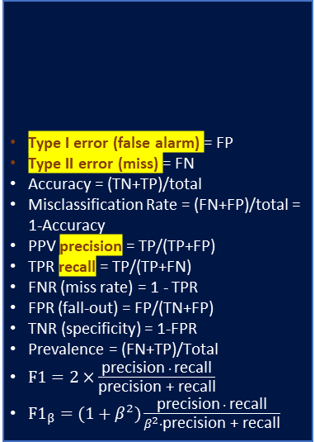
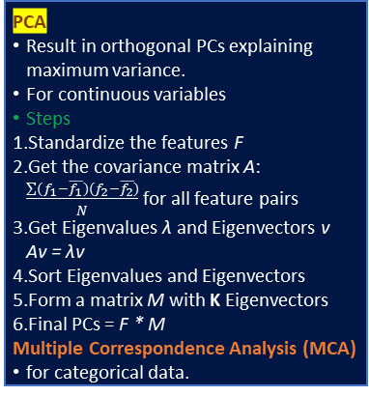
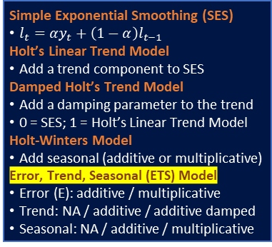
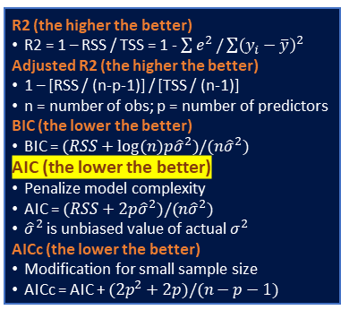
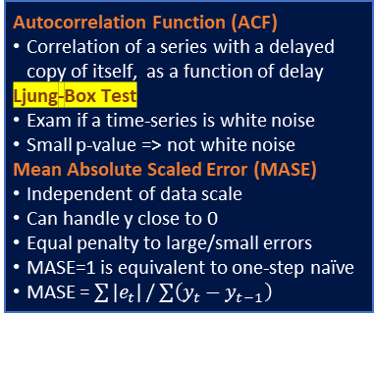
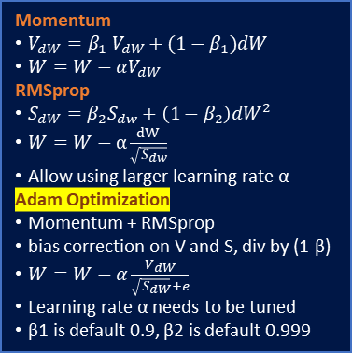
4 Assumptions of Linear Regression
Linear in parameters
Independent X
No perfect multicollinearity
X not correlated to residuals
Residuals
0 mean
equal variance
no autocorrelation
normality
Normal X and Y if maximum likelihood
PCA
Result in orthogonal PCs explaining maximum variance.
For continuous variables
Steps
Standardize the features F
Get the covariance matrix A: $\frac{\sum{(f_{1}−\overline{f_{1}})(f_{2}−\overline{f_{2}})}}{N}$ for all feature pairs
Get Eigenvalues λ and Eigenvectors v Av = λv
Sort Eigenvalues and Eigenvectors
Form a matrix M with K Eigenvectors
Final PCs = F * M
Multiple Correspondence Analysis (MCA)
for categorical data.
K-means Clustering
To minimize within-cluster-variation
Standardized continuous variables
Generalization (Gaussian Mixture)
No need standardized features
k-modes, k-prototypes
Non continuous variables
Optimal number of K
Silhouette coefficient
Steps
Randomly select centroids.
Assign all points to closest centroids.
Recompute centroids of newly formed clusters.
Repeat 2 and 3.
Entropy
Level of information/uncertainty
Entropy of a discrete random variable X with n possible outcomes:
Relative Entropy (KL Divergence)
How one probability distribution (PD) is different from a reference PD.
For discrete probability P and Q defined on the same probability space X, the relative entropy from Q to P:
Autocorrelation Function (ACF)
Correlation of a series with a delayed copy of itself, as a function of delay
Ljung-Box Test
Exam if a time-series is white noise
Small p-value => not white noise
Mean Absolute Scaled Error (MASE)
Independent of data scale
Can handle y close to 0
Equal penalty to large/small errors
MASE=1 is equivalent to one-step naïve
MASE = $\sum{|e_{t}|}/\sum{\left(y_{t}−y_{t−1}\right)}$
Type I error (false alarm) = FP
Type II error (miss) = FN
Accuracy = (TN+TP)/total
Misclassification Rate = (FN+FP)/total = 1-Accuracy
PPV precision = TP/(TP+FP)
TPR recall = TP/(TP+FN)
FNR (miss rate) = 1 - TPR
FPR (fall-out) = FP/(TN+FP)
TNR (specificity) = 1-FPR
Prevalence = (FN+TP)/Total
$F1=2×\frac{\text{precision} ∙ \text{recall}}{\text{precision}\text{ + }\text{recall}}$
$F1_{β}=(1+β^{2})\frac{\text{precision} ∙ \text{recall}}{β^{2}∙\text{precision}\text{ + }\text{recall}}$
 |  | predictions
 |  | 0 | 1
actual | 0 | TN | FP
 | 1 | FN | TP
R2 (the higher the better)
R2 = 1 – RSS / TSS = 1 - $\sum{e^{2}}/\sum{{\left(y_{i}−\overline{y}\right)}^{2}}$
Adjusted R2 (the higher the better)
1 – [RSS / (n-p-1)] / [TSS / (n-1)]
n = number of obs; p = number of predictors
BIC (the lower the better)
BIC = $(RSS+log⁡(n)p{\hat{σ}}^{2})/(n{\hat{σ}}^{2})$
AIC (the lower the better)
Penalize model complexity
AIC = $(RSS+2p{\hat{σ}}^{2})/(n{\hat{σ}}^{2})$
${\hat{σ}}^{2}$ is unbiased value of actual $σ^{2}$
AICc (the lower the better)
Modification for small sample size
AICc = AIC + $(2p^{2}+2p)/(n−p−1)$
Simple Exponential Smoothing (SES)
$l_{t}=αy_{t}+\left(1−α\right)l_{t−1}$
Holt’s Linear Trend Model
Add a trend component to SES
Damped Holt’s Trend Model
Add a damping parameter to the trend
0 = SES; 1 = Holt’s Linear Trend Model
Holt-Winters Model
Add seasonal (additive or multiplicative)
Error, Trend, Seasonal (ETS) Model
Error (E): additive / multiplicative
Trend: NA / additive / additive damped
Seasonal: NA / additive / multiplicative
Maximum Likelihood Estimation (MLE)
Parameter (point) estimation
Formulate log-likelihood based on assumed distribution
Optimize with gradient descent, quasi-newton etc.
Bagging (Bootstrap Aggregating)
Bootstrap
Repeatedly sample with replacement
Form N models with the same bias
On average takes around 2/3 of data
Averaging to reduce variance
Random Forest
Also sample m predictors before split
Biased toward frequent classes
Boosting
Iteratively build weak classifiers
At each iteration, assign more weight to observations with larger error
Sensitive to outliers
ARIMA
Autoregressive: p lagged observations
Moving Average: q lagged errors
d number of differencing
Seasonal ARIMA(p,d,q)(P,D,Q)m
(P,D,Q): seasonal diff and lags
m: number of obs per period
Dynamic Regression (ARIMA X)
Combine external predictors
Model error term as ARIMA process
Dynamic Harmonic Regression
Non-seasonal ARIMA + Fourier terms
Assume fixed seasonal patterns
Momentum
$V_{dW}=β_{1} V_{dW}+(1−β_{1})dW$
$W=W−αV_{dW}$
RMSprop
$S_{dW}=β_{2}S_{dw}+\left(1−β_{2}\right)dW^{2}$
$W=W−α\frac{dW}{\sqrt{S_{dw}}}$
Allow using larger learning rate α
Adam Optimization
Momentum + RMSprop
bias correction on V and S, div by (1-β)
$W=W−α\frac{V_{dW}}{\sqrt{S_{dW}}+e}$
Learning rate α needs to be tuned
β1 is default 0.9, β2 is default 0.999
Central Limit Theorem
Sample means are normally distributed
Shapiro-Wilk Test
H0: Normally Distributed
t-test
Compare means of two samples
Assumption: sample from normal (with equal variances if Student)
H0: equal (large/small)
ANOVA
Compare means of multiple samples
Assumption: independent, normal, homoscedasticity (equal variances)
H0: equal
F-test
Compare variances of two samples
Assumption: sample from normal
H0: equal (large/small)
Chi-Square Test
Independence between two categorical variables
H0: independent
Stationary
Constant mean, variance, autocorrelation over time.
Box-Cox Transformation
Variance Stabilization
Useful for ts with increasing variation
Useful to ARIMA (but not ETS)
Differencing (non-seasonal / seasonal)
Mean Stabilization
Shapley Value
Distribution of payoff among players
Under fair conditions:
no waste: all payoff distributed
Equal contribution, equal payoff
Zero contribution, zero payoff
The game cannot be divided further
Avg expected marginal contribution of a player from all possible combinations.
VARMA
Vector ARMA: generalized to multivariate time-series.

